Slide 1
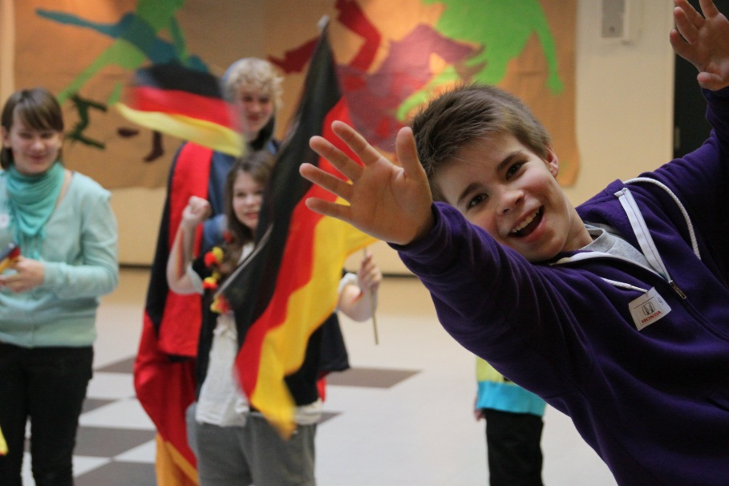
The German Language Adventure: Discover Germany in 16 challenges COALA 1 November 2013 Institut Français D‘Ecosse, Edinburgh

Slide 2
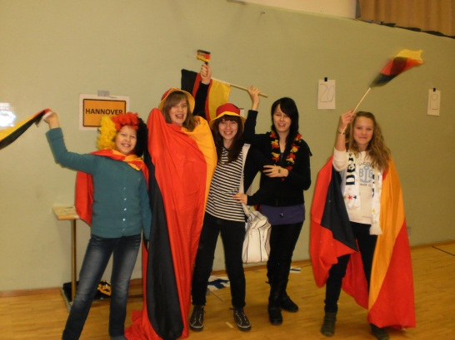
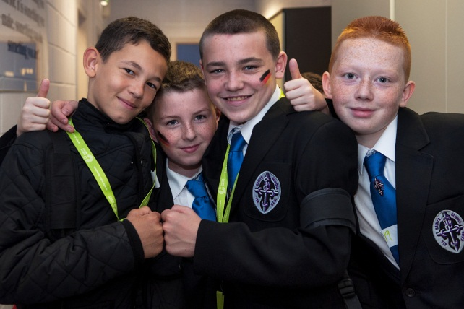
Origins
Developed in Finland
Tested in Estonia & Finland
http://www.goethe.de/ins/gb/gla/lhr/de11459627.htm
Adapted for Schools in Scotland

Slide 3
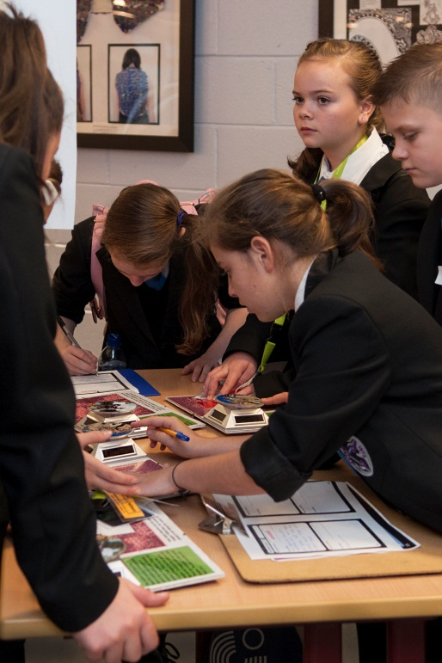
Pilot
Pupils really enjoyed the event. They found it worthwhile, interesting, and exciting and they forgot they were learning. This is true of all pupils of all abilities.
Aileen Mullan, Chryston HS
October 2013
North Lanarkshire:
Chryston High School
City of Glasgow:
All Saints Secondary

Slide 4
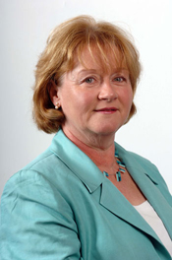
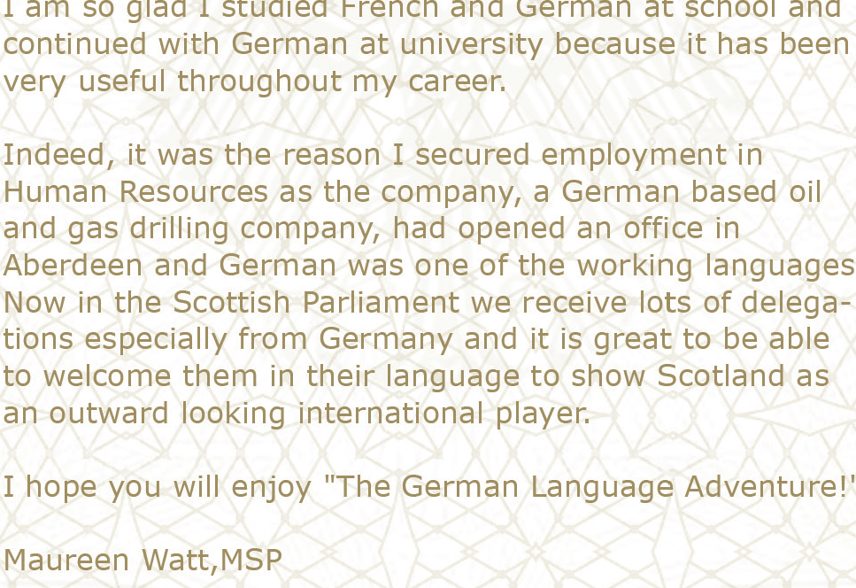
Co-operations
SCILT
Accompanied the pilot with valueable support and advice
Further co-operation for the activity in 2014 will be discussed

Slide 5
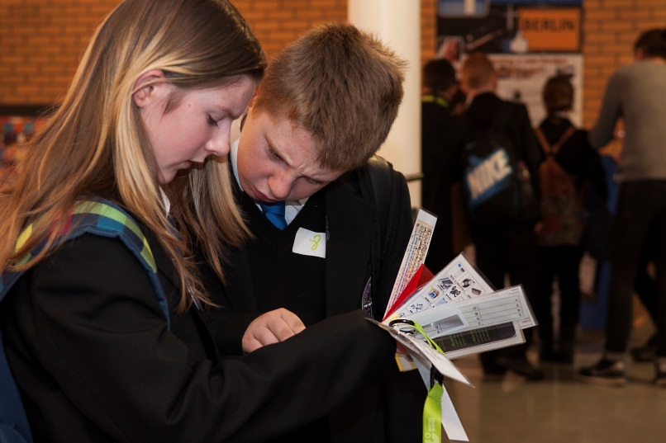
Offer
A team of native German speakers will visit your school and set up a German adventure course with 16 discovery stations for a morning or afternoon of interactive German language fun. The game can be run for groups of 30-100 participants and takes about 3 hours including a prize giving ceremony at the end. The game is run by the
German team and all materials
are supplied by the
Goethe-Institut.

Slide 6
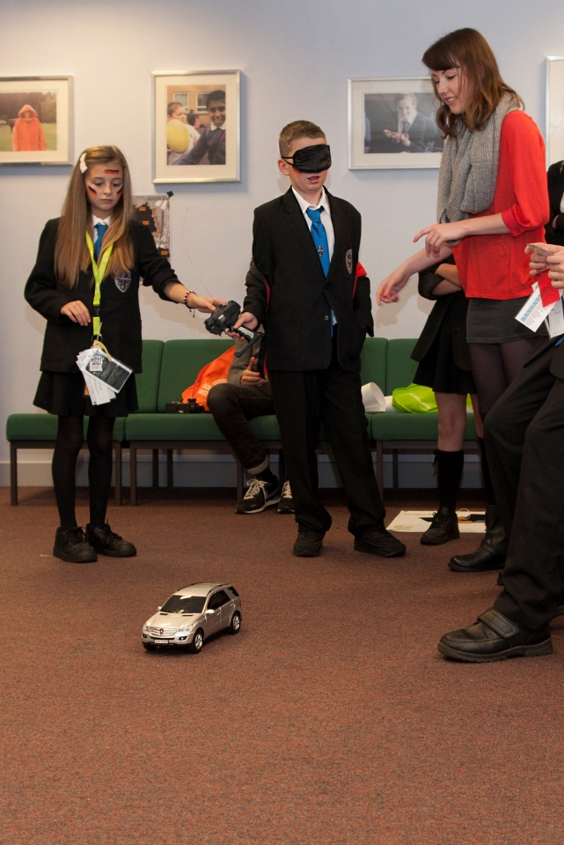
Funding
‘
Funded through the Goethe-Institut and German Government in 2014
Possibly contributions
towards travel or
overnight accomodation
required

Slide 7
Thank you! Stay in touch: language@glasgow.goethe.org Boergmann@glagow.goethe.org

